Slide 1
Practical Implementations
Mathias Nilsson
NMR Methodology Group
University of Manchester
Manchester
September 12th , 2017

Slide 2
Practical Implementations: overview
UoM implementation packages for Varian and Bruker
Practical considerations
Linear prediction
(Pulse sequence code examples)

Slide 3
Practical Implementations: overview
UoM implementation packages for Varian and Bruker
Practical considerations
Linear prediction
(Pulse sequence code examples)
Download from our website:
http://nmr.chemistry.manchester.ac.uk/pureshift
The Bruker and Varian/Agilent pure shift data and software archives
can also be downloaded from DOI:10.17632/w9nz44cyft.1 and DOI:10.17632/rgj4jwcsnz.1 respectively.

Slide 4
UoM package (Varian and Bruker)
Bruker Avance III/Neo Varian VNMRS
(TopSpin 3/4) (VnmrJ 4)
Example data/parameters X X
(500 MHz, quinine in DMSO-d₆)
Pulse sequences X X
Setup macros X
Processing macros X X
Pulse shapes X X
Manual X X

Slide 5
UoM package: 1D experiments
Bruker Varian
Interferogram
PSYCHE X X
TSE-PSYCHE X X
Zangger-Sterk X X
BS X X
BS (multiple frequencies) X
BIRD X
Real time
BIRD X X
BS X X
Zangger-Sterk X X
Experimental data provided includes both raw data and assembled pure shift data

Slide 6
UoM package: 2D experiments
Bruker Varian
Interferogram
PSYCHE 2DJ X
F₁-PSYCHE-TOCSY X
PSYCHE-iDOSY X
Real time
HSQC-BIRD X
edHSQC-BIRD X X
We have various other experiments available, not yet part of the package.
Check for updates on our website:
http://nmr.chemistry.manchester.ac.uk/

Slide 7
UoM package: naming convention
Pulse sequences
Convention is a general guide, not all sequences fit in logically
UoM_2d_if_PS_TOCSY_ts4.c
Examples:
1D interferogram using BIRD: UoM_1d_if_BIRD
2D real time HSQC: UoM_2d_rt_BIRD_gHSQC
2D TOCSY with
F₁ PSYCHE decoupling: UoM_2d_id_PSYCHE_TOCSY
Generic (PS) or specific pure shift element
Dimensionality of pure shift spectrum
Possible extension and/or version
Interferogram (if), real time (rt), indirect dimension (id), or constant time (ct)
Parent experiment, if other than pulse acquire

Slide 8
UoM package: naming convention
Macros
Setup macros (currently Varian only):
As pulse sequence, but starting with ‘UoM_setup’
PS is replaced with specific pure shift element
Processing macros:
if or rt for each dimensionality (not needed if id or ct):
UoM_proc_1d_if, UoM_proc_1d_rt,
UoM_proc_2d_if, UoM_proc_2d_rt,
Examples:
BIRD real time gradient HSQC
setup: UoM_setup_2d_rt_BIRD_gHSQC
process: UoM_proc_2d_rt

Slide 9
UoM package: setup macros
Varian only (for now):
e.g. UoM_setup_1d_rt_ZS, UoM_setup_2d_BIRD_gHSQC
Run the macro from a standard ¹H experiment
Sets up an experiment with (hopefully) sensible acquisition parameters as
listed in the manual
Sets wexp=‘<processing macro>’ to produce a pure shift spectrum
when “au” is used for acquisition
Saving of results is left to user

Slide 10
UoM package: Varian shaped pulses
Calculated on the fly if kp_auto=‘y’ [default]
based on user parameters including (a for active spin):
bw_a bandwidth
offset
kp_wave_a pulse shape (e.g. rsnob or psyche)
kp_beta_a flip angle (default: 180° for ZS; 4 for PSYCHE*)
Setting the parameters (user responsibility if kp_auto=‘n’) :
shp_a shapefile name in shapelib
pw180_a duration of the pulse [μs]
pwr180_a power of the pulse [dB]
Additions to wavelib:
/vnmr/wavelib/inversion/psyche
/vnmr/wavelib/inversion/kp2_wurst180
/vnmr/wavelib/decoupling/kp_WURST40
Detailed information in the manual
*nominal value is confusing, refer to manual

Slide 11
UoM package: Bruker shaped pulses
Calculating pulse shapes
Done using standard tools
On the fly implementation in the future?
Shapes provided
PSYCHE elements of different durations
compromise between artefact suppression and T₂ weighting
flip angle set by CNST 20
180° CHIRP
for TSE (triple spin echo) experiments, and ZQC suppression
Detailed information in the manual

Slide 12
UoM package: processing macros
Varian
Keep a copy of the raw data in expX/pureshift
can be recalled using ‘UoM_unpureshift’
Bruker
Create a new experiment: current +1000 (warns before overwrite)
Names
Interferogram 1D experiments
UoM_proc_1d_if (Bruker: same as pshift)
Real-time 1D experiments (only Varian in current implementation)
UoM_proc_1d_rt
Interferogram 2D experiments (only Bruker in current implementation)
UoM_proc_2d_if (Bruker: same as pshift)
Real-time 2D experiments (only Varian in current implementation)
UoM_proc_2d_rt

Slide 13
Practical Implementations: overview
UoM implementation package for Varian and Bruker
Practical considerations
Linear prediction
(Pulse sequence code examples)

Slide 14
Pure shift: how do we get a clean spectrum?
Conventional ¹H spectrum
This is our starting point
Ideal pure shift spectrum
Clean, sharp, sensitive
With SAPPHIRE we are pretty close to the ideal
First attempt pure shift spectrum
Severe problems with artefacts/sidebands
Typical current pure shift spectrum
Clean enough for most applications
approx. 3%

Slide 15
Prototypical pure shift sequences
How do we implement practical pulse sequences?
Implement as a 2D experiment to allow ‘natural’ use
with easy setup using standard parameters
Allow flexibility regarding J-refocusing element
½t₁
½t₁
Excite
ASR
Acq
Interferogram
J-refocus
1/sw₁
Prune distorted data points at start of each chunk
Make sure to refocus J in the middle of chunk.
[
]
Excite
Acq
ASR
Acq
Real-time
J-refocus
n

Slide 16
Pure shift: practical experiments
Implement interferogram acquisition as a ’standard’ 2D experiment
The use of SW₁ to determine chunk size is easily translated to chunk duration: chunk duration = 1/SW₁
SW/SW₁ needs to be an integer to avoid
phase discontinuities between chunks
1/SW₁ should be short compared to 1/J to avoid artefacts, but
is a compromise with experiment time
Allow flexibility regarding J-refocusing element
One sequence or many?
Refocus J in the middle of the chunk
Sideband shapes and phases determined by J-refocusing position
Prune distorted data points from start of each chunk
Distorted early data points cause severe chunking artefacts

Slide 17
Chunking sidebands
Acquiring pure shift data in chunks of duration 1/SW₁ gives rise to
J-sidebands with a spacing SW₁ in the spectrum
Pure shift FID
Pure shift spectrum
Envelope
Chunk duration = 1/SW₁
Sideband spacing = SW₁
Amplitude of the n^{th} sideband for an AX system:
(cos²[πn] − αn cot[π⁄2α] sin[2πn])⁄
(1 − 4αn²)
α=SW₁/J
J. Magn. Reson. 271, 99 (2016)

Slide 18
Effect of SW₁ / chunk duration; J = 7.5 Hz
FID envelope
Pure shift spectrum
“Typical” SW₁ = 50.0 Hz
20 ms
approx. 3%
J-sidebands
SW₁ = 35.7 Hz
28 ms
SW₁ = 20.0 Hz
50 ms

Slide 19
Effect of SW/SW₁ ≠ an integer
SW/SW₁ = 19.6 (SW₁ = 102 Hz, SW = 1000 Hz)
δ= 0 Hz (on resonance)
Only weak J-sidebands
Frequency-dependent phase discontinuity between chunks
δ= 50 Hz
δ= 100 Hz

Slide 20
Effect of J refocusing position
FID envelope
Pure shift spectrum
J refocused at the beginning of each chunk
Original
experiment
J refocused at the beginning of the first (half) chunk
and in the middle of successive ones
Current
experiment
J refocused in the middle of each chunk
Current
experiment

Slide 21
Effect of distorted early data points
In practice the first few data points of a FID are always distorted Modern digital filtering methods often make this worse
FID envelope
Pure shift spectrum
No distortion
First two points distorted

Slide 22
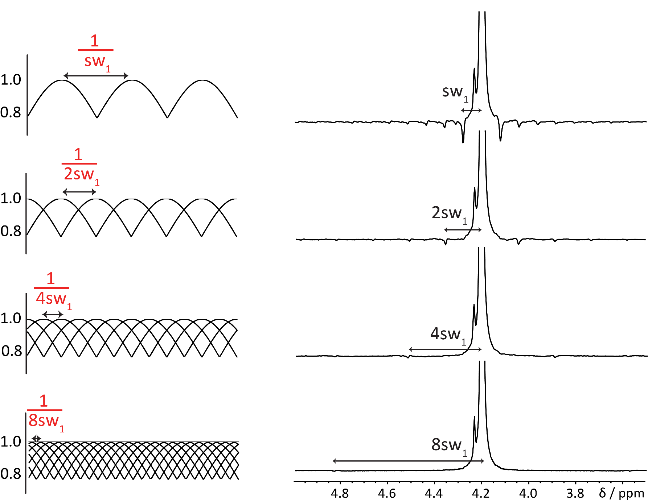
SAPPHIRE: getting rid of sidebands by modulation averaging
Systematically varying the timing of the first chunk suppresses sidebands
to order N in N+1 experiments.
N = 0
N = 1
N = 3
Averaging spectra measured with different SW₁ can reduce sidebands, but does not suppress them
J. Magn. Reson. 259, 207 (2015)
Chem. Commun. In press (2017), DOI: 10.1039/c7cc04423b

Slide 23
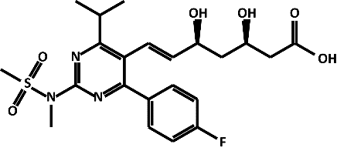
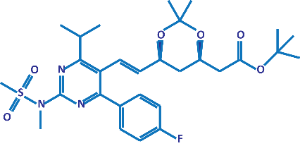
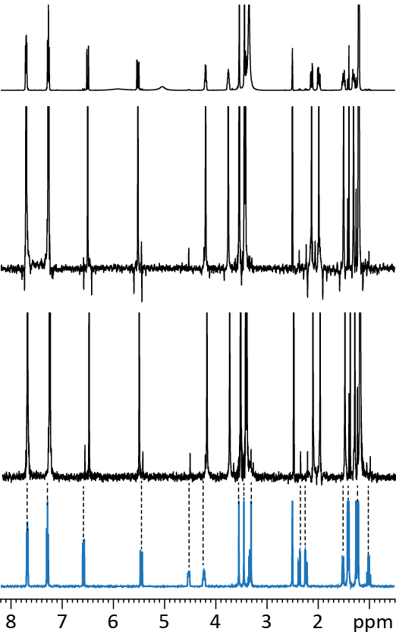
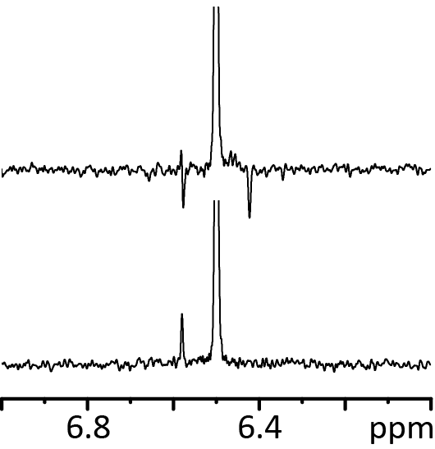
SAPPHIRE application: impurity analysis
+
2.8 % BEM (precursor)
97.2 % rosuvastatin
Normal ¹H spectrum
(mixture)
A signal of BEM is accidentally suppressed by overlap with a negative sideband.
Conventional ZS pure shift spectrum
SAPPHIRE ZS pure shift spectrum
Rosuvastatin
BEM
Normal ¹H spectrum
(BEM)

Slide 24
Practical Implementations: overview
UoM implementation package for Varian and Bruker
Practical considerations
Linear prediction
(Pulse sequence code examples)

Slide 25
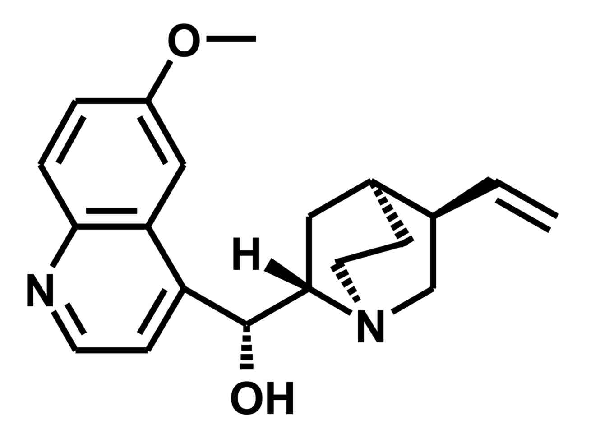
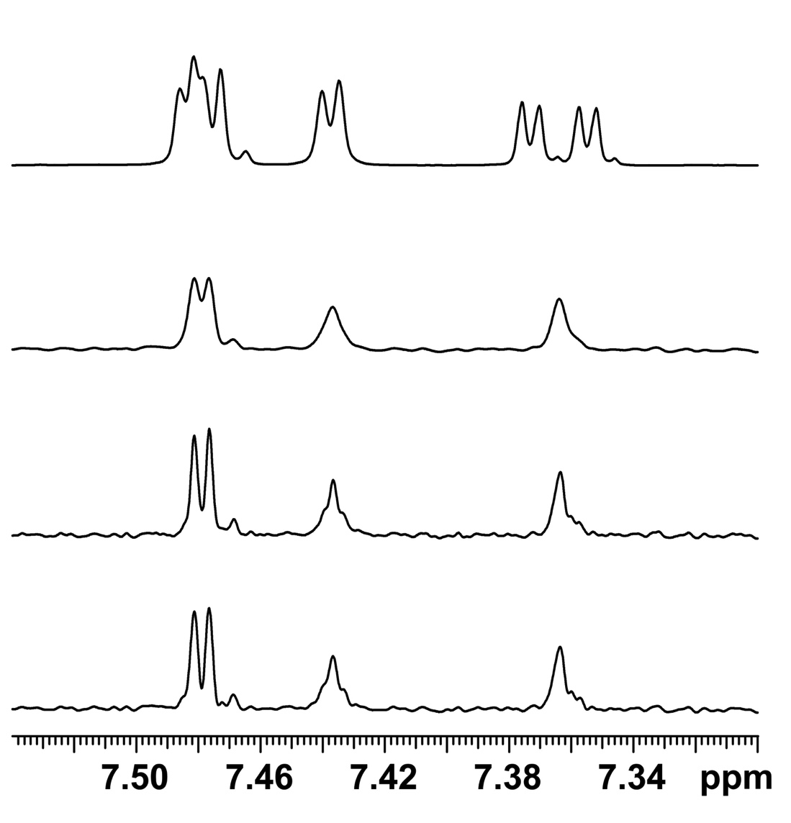
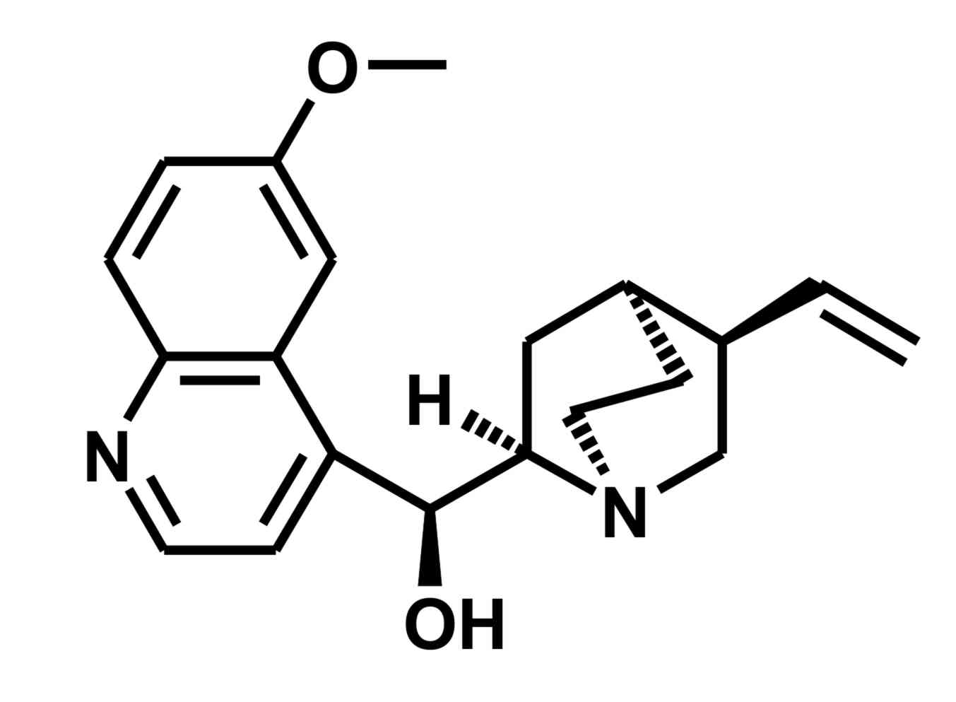
Linear prediction: 500 MHz ¹H spectra of a quinine and quinidine mixture
Hb
Hc
Ha
Ha
Ha
Hc
Hb
Hc
Conventional
quinine
Impurity
Hb
Pure shift: 8192 points
Hc
Ha
Pure shift: 16384 points
Pure shift: LP from 8192
to 16384 points
quinidine
Hb

Slide 26
A Pure Shift NMR Workshop
11.00 Gareth Morris Welcome, introduction and history
11.30 Peter Kiraly Interferogram and real-time acquisition methods
12.00 Laura Castañar Zangger-Sterk and band-selective methods
12.30 Mohammadali Foroozandeh PSYCHE
13.00 Lunch and poster session
14.00 Ralph Adams Other pure shift and related methods
14.30 Mathias Nilsson Practical implementations
15.00 Adolfo Botana JEOL pure shift implementation
15.10 Vadim Zorin MestreNova pure shift implementation
15.20 Ēriks Kupče Bruker shaped pulse implementation
15.30 Question and answer session
University of Manchester, 12th September 2017

Slide 27
Practical Implementations: overview
UoM implementation packages for Varian and Bruker
Practical considerations
Pulse sequence code examples
Linear prediction

Slide 28
Interferogram implementation: Varian (stripped down sequence)
pulsesequence()
{
droppts = getval("droppts"), /* number of dummy points to acquire */
status(B);
rgpulse(pw,v1,rof1,0.0); / *hard 90 pulse*/
delay(d2/2.0);
obspower(pplvl);
delay(0.25/sw1-rof1-gt1-gstab); /* refocus mid-chunk*/
zgradpulse(gzlvl1,gt1);
delay(gstab);
rgpulse(pp,v2,rof1,rof1); /* hard 180 pulse; start ZS element */
obspower(pwr180_a);
delay(gstab);
zgradpulse(gzlvl1,gt1);
delay(0.25/sw1-rof1-gt1-gstab); /* refocus mid-chunk*/
delay(droppts/sw); /* droppoints */
delay(tau_a-rof1-gt2-gstab+rof2);
zgradpulse(gzlvl2,gt2);
delay(gstab);
rgradient('z',gzlvl7);
shaped_pulse(shp_a,pw180_a,v3,rof1,rof1); /* soft 180 pulse */
rgradient('z',0.0); /* end ZS element */
delay(gstab);
zgradpulse(gzlvl2,gt2);
delay(tau_a-rof1-gt2-gstab);
delay(d2/2.0);
status(C);
}
Implemented as a 2D experiment ☐
Allow different J-refocusing ☐
Refocus J in the middle of the chunk ☐
Prune distorted data points ☐

Slide 29
Interferogram implementation: Varian (stripped down sequence)
pulsesequence()
{
droppts = getval("droppts"), /* number of dummy points to acquire */
status(B);
rgpulse(pw,v1,rof1,0.0); / *hard 90 pulse*/
delay(d2/2.0);
obspower(pplvl);
delay(0.25/sw1-rof1-gt1-gstab); /* refocus mid-chunk*/
zgradpulse(gzlvl1,gt1);
delay(gstab);
rgpulse(pp,v2,rof1,rof1); /* hard 180 pulse; start ZS element */
obspower(pwr180_a);
delay(gstab);
zgradpulse(gzlvl1,gt1);
delay(0.25/sw1-rof1-gt1-gstab); /* refocus mid-chunk*/
delay(droppts/sw); /* droppoints */
delay(tau_a-rof1-gt2-gstab+rof2);
zgradpulse(gzlvl2,gt2);
delay(gstab);
rgradient('z',gzlvl7);
shaped_pulse(shp_a,pw180_a,v3,rof1,rof1); /* soft 180 pulse */
rgradient('z',0.0); /* end ZS element */
delay(gstab);
zgradpulse(gzlvl2,gt2);
delay(tau_a-rof1-gt2-gstab);
delay(d2/2.0);
status(C);
}
Implemented as a 2D experiment ☑
Allow different J-refocusing ☐
Refocus J in the middle of the chunk ☐
Prune distorted data points ☐

Slide 30
Interferogram implementation: Varian (stripped down sequence)
pulsesequence()
{
droppts = getval("droppts"), /* number of dummy points to acquire */
status(B);
rgpulse(pw,v1,rof1,0.0); / *hard 90 pulse*/
delay(d2/2.0);
obspower(pplvl);
delay(0.25/sw1-rof1-gt1-gstab); /* refocus mid-chunk*/
zgradpulse(gzlvl1,gt1);
delay(gstab);
rgpulse(pp,v2,rof1,rof1); /* hard 180 pulse; start ZS element */
obspower(pwr180_a);
delay(gstab);
zgradpulse(gzlvl1,gt1);
delay(0.25/sw1-rof1-gt1-gstab); /* refocus mid-chunk*/
delay(droppts/sw); /* droppoints */
delay(tau_a-rof1-gt2-gstab+rof2);
zgradpulse(gzlvl2,gt2);
delay(gstab);
rgradient('z',gzlvl7);
shaped_pulse(shp_a,pw180_a,v3,rof1,rof1); /* soft 180 pulse */
rgradient('z',0.0); /* end ZS element */
delay(gstab);
zgradpulse(gzlvl2,gt2);
delay(tau_a-rof1-gt2-gstab);
delay(d2/2.0);
status(C);
}
Implemented as a 2D experiment ☑
Allow different J-refocusing ☑
Refocus J in the middle of the chunk ☐
Prune distorted data points ☐

Slide 31
Interferogram implementation: Varian (stripped down sequence)
pulsesequence()
{
droppts = getval("droppts"), /* number of dummy points to acquire */
status(B);
rgpulse(pw,v1,rof1,0.0); / *hard 90 pulse*/
delay(d2/2.0);
obspower(pplvl);
delay(0.25/sw1-rof1-gt1-gstab); /* refocus mid-chunk*/
zgradpulse(gzlvl1,gt1);
delay(gstab);
rgpulse(pp,v2,rof1,rof1); /* hard 180 pulse; start ZS element */
obspower(pwr180_a);
delay(gstab);
zgradpulse(gzlvl1,gt1);
delay(0.25/sw1-rof1-gt1-gstab); /* refocus mid-chunk*/
delay(droppts/sw); /* droppoints */
delay(tau_a-rof1-gt2-gstab+rof2);
zgradpulse(gzlvl2,gt2);
delay(gstab);
rgradient('z',gzlvl7);
shaped_pulse(shp_a,pw180_a,v3,rof1,rof1); /* soft 180 pulse */
rgradient('z',0.0); /* end ZS element */
delay(gstab);
zgradpulse(gzlvl2,gt2);
delay(tau_a-rof1-gt2-gstab);
delay(d2/2.0);
status(C);
}
Implemented as a 2D experiment ☑
Allow different J-refocusing ☑
Refocus J in the middle of the chunk ☑
Prune distorted data points ☐

Slide 32
Interferogram implementation: Varian (stripped down sequence)
pulsesequence()
{
droppts = getval("droppts"), /* number of dummy points to acquire */
status(B);
rgpulse(pw,v1,rof1,0.0); / *hard 90 pulse*/
delay(d2/2.0);
obspower(pplvl);
delay(0.25/sw1-rof1-gt1-gstab); /* refocus mid-chunk*/
zgradpulse(gzlvl1,gt1);
delay(gstab);
rgpulse(pp,v2,rof1,rof1); /* hard 180 pulse; start ZS element */
obspower(pwr180_a);
delay(gstab);
zgradpulse(gzlvl1,gt1);
delay(0.25/sw1-rof1-gt1-gstab); /* refocus mid-chunk*/
delay(droppts/sw); /* droppoints */
delay(tau_a-rof1-gt2-gstab+rof2);
zgradpulse(gzlvl2,gt2);
delay(gstab);
rgradient('z',gzlvl7);
shaped_pulse(shp_a,pw180_a,v3,rof1,rof1); /* soft 180 pulse */
rgradient('z',0.0); /* end ZS element */
delay(gstab);
zgradpulse(gzlvl2,gt2);
delay(tau_a-rof1-gt2-gstab);
delay(d2/2.0);
status(C);
}
Implemented as a 2D experiment ☑
Allow different J-refocusing ☑
Refocus J in the middle of the chunk ☑
Prune distorted data points ☑

Slide 33
Interferogram implementation: Bruker (stripped down sequence)
define delay tauA
define delay tauC
"d0=0"
"in0=inf1/2"
"tauA=in0/2-p16-d16-50u” ;refocus mid-chunk
"tauC=dw*2*cnst4” ;use cnst4 for droppoints
1 ze
2 d11
3 d1 pl1:f1
p1 ph1 ;hard 90
d0
tauA ;refocus mid-chunk
p16:gp1
d16
p2 ph2 ;hard 180 pulse; start ZS element
p16:gp1
d16
50u
tauA ;refocus mid-chunk
tauC ;droppoints
50u
d17
p17:gp2
d17
20u gron0 pl0:f1
(p12:sp12 ph3):f1 ;soft 180
20u groff pl1:f1 ;end ZS element
d17
p17:gp2
d17
d0
go=2 ph31
d11 mc #0 to 2 F1QF(id0)
Implemented as a 2D experiment ☐
Allow different J-refocusing ☐
Refocus J in the middle of the chunk ☐
Prune distorted data points ☐

Slide 34
Interferogram implementation: Bruker (stripped down sequence)
define delay tauA
define delay tauC
"d0=0"
"in0=inf1/2"
"tauA=in0/2-p16-d16-50u” ;refocus mid-chunk
"tauC=dw*2*cnst4” ;use cnst4 for droppoints
1 ze
2 d11
3 d1 pl1:f1
p1 ph1 ;hard 90
d0
tauA ;refocus mid-chunk
p16:gp1
d16
p2 ph2 ;hard 180 pulse; start ZS element
p16:gp1
d16
50u
tauA ;refocus mid-chunk
tauC ;droppoints
50u
d17
p17:gp2
d17
20u gron0 pl0:f1
(p12:sp12 ph3):f1 ;soft 180
20u groff pl1:f1 ;end ZS element
d17
p17:gp2
d17
d0
go=2 ph31
d11 mc #0 to 2 F1QF(id0)
Implemented as a 2D experiment ☑
Allow different J-refocusing ☐
Refocus J in the middle of the chunk ☐
Prune distorted data points ☐

Slide 35
Interferogram implementation: Bruker (stripped down sequence)
define delay tauA
define delay tauC
"d0=0"
"in0=inf1/2"
"tauA=in0/2-p16-d16-50u” ;refocus mid-chunk
"tauC=dw*2*cnst4” ;use cnst4 for droppoints
1 ze
2 d11
3 d1 pl1:f1
p1 ph1 ;hard 90
d0
tauA ;refocus mid-chunk
p16:gp1
d16
p2 ph2 ;hard 180 pulse; start ZS element
p16:gp1
d16
50u
tauA ;refocus mid-chunk
tauC ;droppoints
50u
d17
p17:gp2
d17
20u gron0 pl0:f1
(p12:sp12 ph3):f1 ;soft 180
20u groff pl1:f1 ;end ZS element
d17
p17:gp2
d17
d0
go=2 ph31
d11 mc #0 to 2 F1QF(id0)
Implemented as a 2D experiment ☑
Allow different J-refocusing ☑
Refocus J in the middle of the chunk ☐
Prune distorted data points ☐

Slide 36
Interferogram implementation: Bruker (stripped down sequence)
define delay tauA
define delay tauC
"d0=0"
"in0=inf1/2"
"tauA=in0/2-p16-d16-50u” ;refocus mid-chunk
"tauC=dw*2*cnst4” ;use cnst4 for droppoints
1 ze
2 d11
3 d1 pl1:f1
p1 ph1 ;hard 90
d0
tauA ;refocus mid-chunk
p16:gp1
d16
p2 ph2 ;hard 180 pulse; start ZS element
p16:gp1
d16
50u
tauA ;refocus mid-chunk
tauC ;droppoints
50u
d17
p17:gp2
d17
20u gron0 pl0:f1
(p12:sp12 ph3):f1 ;soft 180
20u groff pl1:f1 ;end ZS element
d17
p17:gp2
d17
d0
go=2 ph31
d11 mc #0 to 2 F1QF(id0)
Implemented as a 2D experiment ☑
Allow different J-refocusing ☑
Refocus J in the middle of the chunk ☑
Prune distorted data points ☐

Slide 37
Interferogram implementation: Bruker (stripped down sequence)
define delay tauA
define delay tauC
"d0=0"
"in0=inf1/2"
"tauA=in0/2-p16-d16-50u” ;refocus mid-chunk
"tauC=dw*2*cnst4” ;use cnst4 for droppoints
1 ze
2 d11
3 d1 pl1:f1
p1 ph1 ;hard 90
d0
tauA ;refocus mid-chunk
p16:gp1
d16
p2 ph2 ;hard 180 pulse; start ZS element
p16:gp1
d16
50u
tauA ;refocus mid-chunk
tauC ;droppoints
50u
d17
p17:gp2
d17
20u gron0 pl0:f1
(p12:sp12 ph3):f1 ;soft 180
20u groff pl1:f1 ;end ZS element
d17
p17:gp2
d17
d0
go=2 ph31
d11 mc #0 to 2 F1QF(id0)
Implemented as a 2D experiment ☑
Allow different J-refocusing ☑
Refocus J in the middle of the chunk ☑
Prune distorted data points ☑

Slide 38
Varian pulse sequence for real-time acquisition (stripped down)
pulsesequence()
{
droppts = getval("droppts"), /* number of dummy points to acquire */
/* will be stripped by post */
/* acquisition macro */
kp_npoints = getval("kp_npoints ") /* number of points per chunk*/
kp_cycles = getval("kp_cycles ") /* number of chunks*/
setacqmode(WACQ|NZ); /* stop DSP to collect zeros*/
loop(v10,v11); /* loop over nchunks*/
rcvron();
delay(rof1);
acquire(droppts,1.0/sw); /* drop points */
if (dm[2]=='y') /* start decoupler for chunk */
{
decprgon(dseq, 1.0/dmf, dres);
decon(); decunblank();
}
acquire(kp_npoints,1.0/sw); /* Acquire chunk*/
if (dm[2]=='y') /* stop decoupler during droppoints */
{
decoff();
decprgoff();
}
acquire(droppts,1.0/sw); /* drop points */
recoff(); }
/* Pure shift ELEMENT HERE */
endloop(v11);

Slide 39
Bruker pulse sequence for real time acquisition (stripped-down)
Avance III/Topspin 3
dwellmode explicit ;before starting actual sequence
ACQ_START(ph30,ph31)
4 0.1u REC_UNBLK ; Start receiver for acquisition
0.05u DWL_CLK_ON ; Start DSP for acquisition
d62 ; Acquire data points (d62 = chunk duration)
0.05u DWL_CLK_ON ; Stop DSP so we don’t acquire zeros during J refocus
0.1u REC_BLK ; Stop Reciever
; J REFOCUS ELEMENT HERE
lo to 4 times l1
d11 do:f2 mc #0 to 2
F1EA(calgrad(EA ACQ_START(ph30,ph31)), caldel(d0, +in0) & calph(ph3, +180) & calph(ph6, +180) & calph(ph31, +180))
Neo/TopSpin 4
ACQ_START(ph30,ph31)
; J REFOCUS ELEMENT HERE
4 0.1u REC_UNBLK ; Start receiver for acquisition
0.05u DWELL_RELEASE ; Start DSP for acquisition
d62 ; Acquire data points d62 = chunk duration)
0.05u DWELL_HOLD ; Stop DSP so we don’t acquire zeros during J refocus
0.1u REC_BLK ; Stop Reciever
; J REFOCUS ELEMENT HERE
lo to 4 times l1
d11 do:f2 mc #0 to 2
F1EA(calgrad(EA ACQ_START(ph30,ph31)), caldel(d0, +in0) & calph(ph3, +180) & calph(ph6, +180) & calph(ph31, +180))

