Slide 1

Pure Shift NMR
Gareth Morris
NMR Methodology Group
University of Manchester
    Tutorial, EUROMAR 2018

Slide 2
Pure Shift NMR
The History: What ? Why ? Who ? When ? How ?
The Mechanics
Some Applications
Some Problems

Slide 3
What Is Pure Shift NMR?
A pure shift spectrum is one in which peak positions are determined solely by chemical shifts
  , but …
… in spectra of systems with homonuclear couplings, a perfect pure shift spectrum is an unattainable ideal: all we can do is to approximate it as closely as possible. Strong coupling sets fundamental limits on our ability to distinguish between coupled spins; and practicalities usually force us to compromise between sensitivity and spectral purity. We want methods that are general, robust, linear …

Slide 4
Pure Shift NMR
The History: What ? Why ? Who ? When ? How ?
The Mechanics
Some Applications
Some Problems

Slide 5
Magnet Development: Proton Resonance Frequency by Year
Maximum commercially available spectrometer field as a function of year, on linear (left) and log (right) scale
?
?
MHz
MHz
Introduction of superconducting magnets

Slide 6
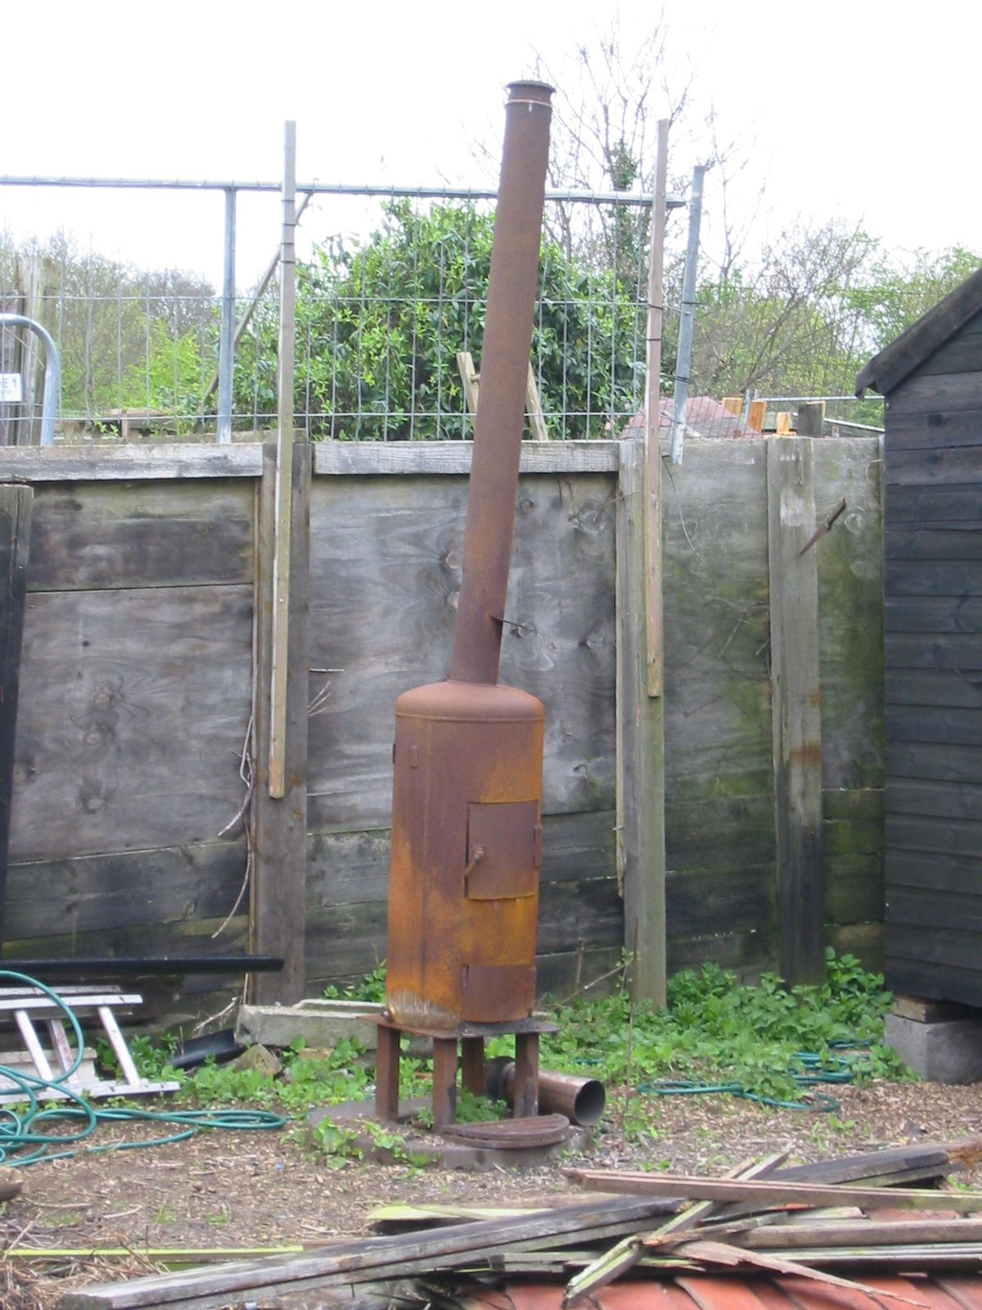
Is High Temperature Superconductivity the Answer?

Slide 7
Pure Shift NMR
The History: What ? Why ? Who ? When ? How ?
The Mechanics
Some Applications
Some Problems

Slide 8
1962: Richard Ernst’s PhD project …
“… My own work dealt with the construction of high sensitivity radio frequency preamplifiers … on the theoretical side, I was concerned with stochastic resonance … I tried in particular to design a scheme of homonuclear broadband decoupling to simplify proton resonance spectra. By applying a stochastic sequence with a shaped power spectral density that has a hole at the observation frequency, all extraneous protons should be decoupled without perturbing the observed proton spin. The theoretical difficulties were mainly concerned with the computation of the response to nonwhite noise. Experiments were not attempted at that time, we did not believe in the usefulness of the concept anyway, and I finished my thesis in 1962 with a feeling like an artist balancing on a high rope without any interested spectators.”
Richard Ernst, Nobel autobiography (1991)

Slide 9
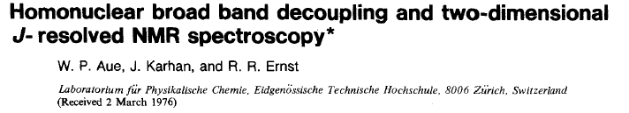
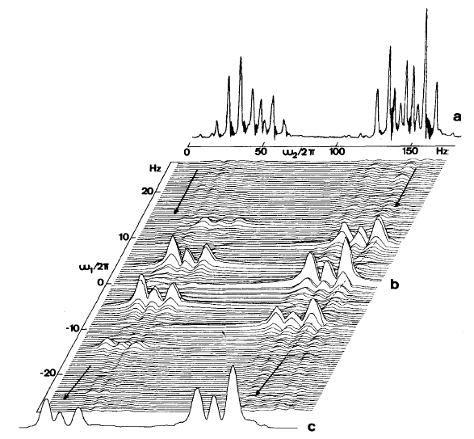
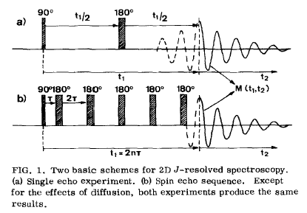
1976: 45° Projection of a 2D J Spectrum
Projecting the 2DJ spectrum of a weakly coupled spin system at 45° to the F₂ axis generates a pure shift spectrum, but only if it is the absolute value spectrum that is projected (which loses most of the resolution gain)
J Chem Phys 64, 4229 (1976)

Slide 10
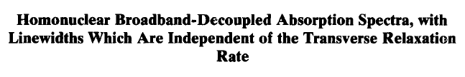

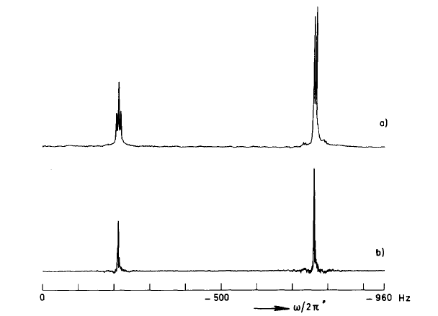
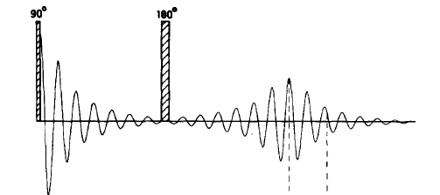
1979: Constant-Time Evolution
t₁
T
Varying t₁ maps out an FID that only depends on chemical shift, but
signal amplitudes oscillate as a function of T
J Magn Reson 35, 167 (1979)

Slide 11
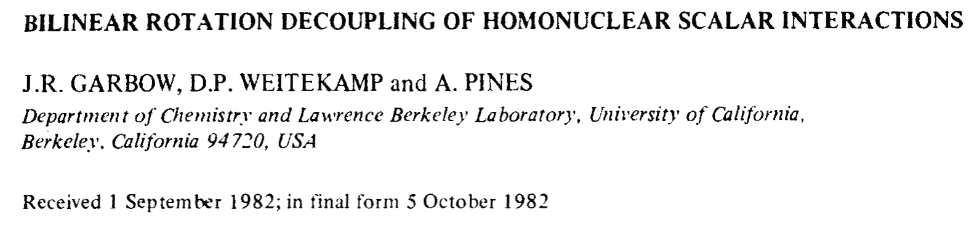
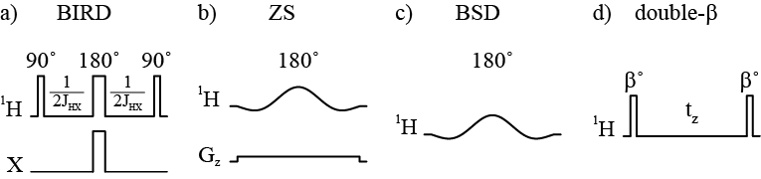
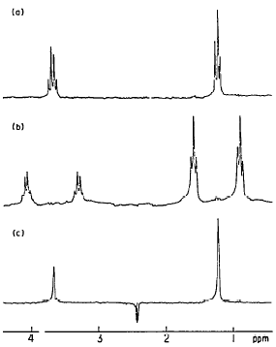

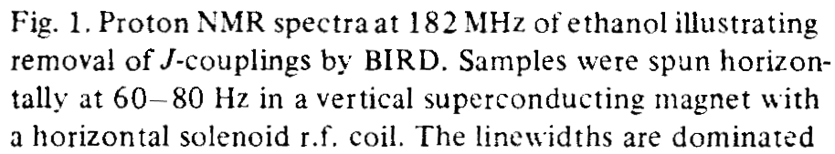
1982: BIRD
¹³C
Using a BIRD sequence element that inverts only ¹³C-attached protons and
a hard 180° pulse at the midpoint of t₁ refocuses the effects of J_{HH}. (First example of a “J-refocused” pure shift experiment)
Chem Phys Lett 93, 504 (1982)

Slide 12

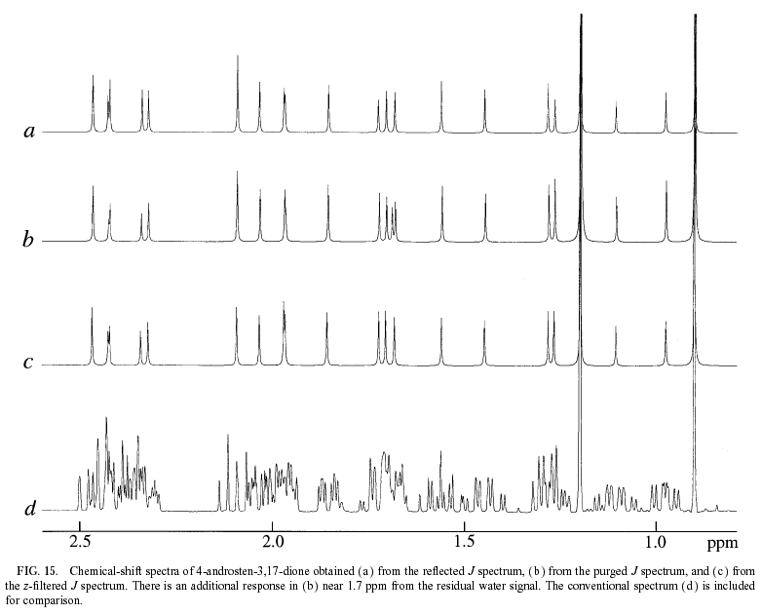
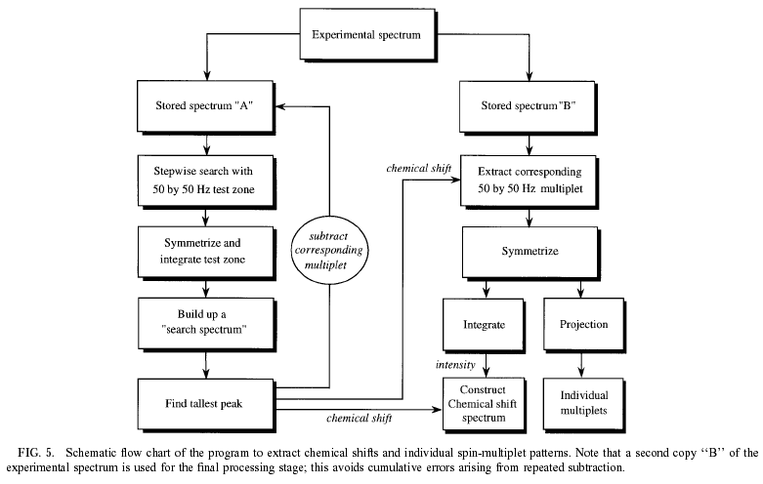
1997: Pattern Recognition in Symmetrised 2D J Spectra
2DJ spectroscopy with a z-filter gives cross-shaped multiplets; nonlinear pattern recognition processing converts these into a pure shift spectrum
J Magn Reson 124, 104 (1997)

Slide 13

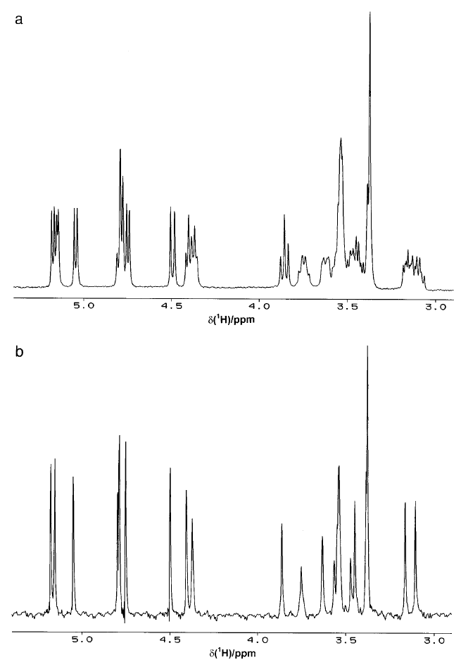
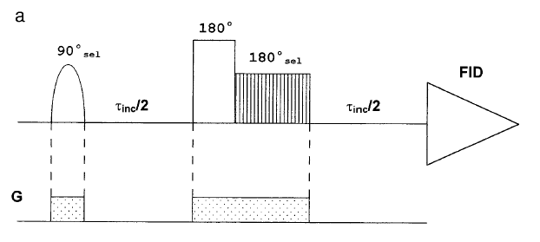
1997 : the Zangger-Sterk Method
½t₁
½t₁
Replacing the BIRD sequence element with a selective 180° pulse in the presence of a field gradient refocuses J in thin slices of the sample.
Observing only these slices gives a pure shift spectrum. (First example of “chunked” pure shift data acquisition)
J Magn Reson 124, 486 (1997)

Slide 14

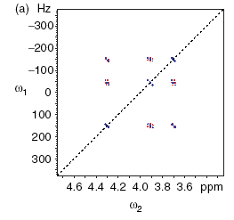
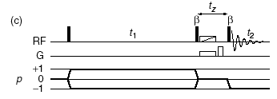
2007 : Anti-z-COSY
A z-filtered anti-z-COSY mixing period restricts multiplet components to those at right angles to the diagonal; filtering out cross-peaks and projecting in this direction gives a pure shift spectrum
Magn Reson Chem 45, 296 (2007)

Slide 15
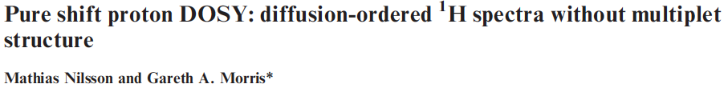
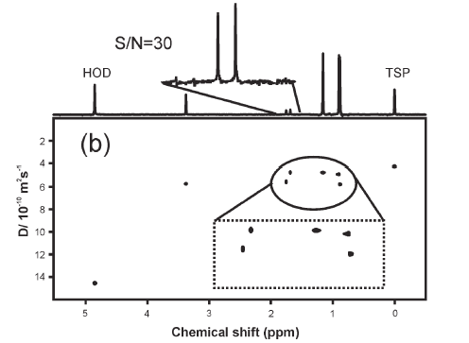
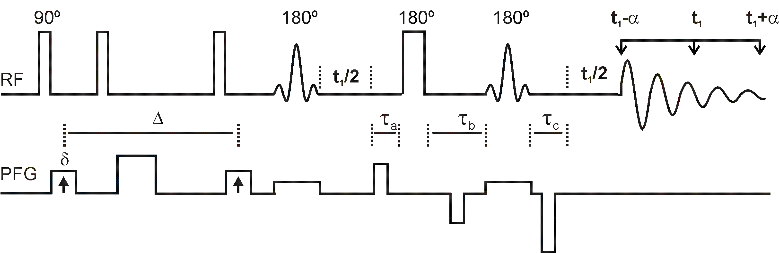
2007 : Zangger-Sterk Revisited / Pure Shift DOSY
1/sw1
0.5/sw1
Using pure shift acquisition avoids signal overlap which would otherwise lead to incorrect apparent D values.
(Updated the ZS method to use PFGs, and changed chunk timing)
Chem. Commun. 2007, 933 (2007)

Slide 16
Pure Shift NMR
The History: What ? Why ? Who ? When ? How ?
The Mechanics
Some Applications
Some Problems

Slide 17
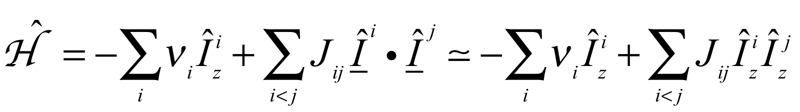
Pure Shift NMR: Broadband Homonuclear Decoupling
We need a way to separate the effects of shifts (δ) and couplings (J), e.g.
Shifts
Couplings
hard 180° pulse
reverses effects of δ but not of J
J-refocusing
reverses effect of J but not of δ, e.g. by combining “active spin refocusing” (reverse δ for chosen spins only) with a hard 180° pulse (inverts all spins)

Slide 18
Pure Shift NMR
The History: What ? Why ? Who ? When ? How ?
The Mechanics:
the Zangger-Sterk experiment, J-refocusing and PSYCHE
Some Applications
Some Problems

Slide 19
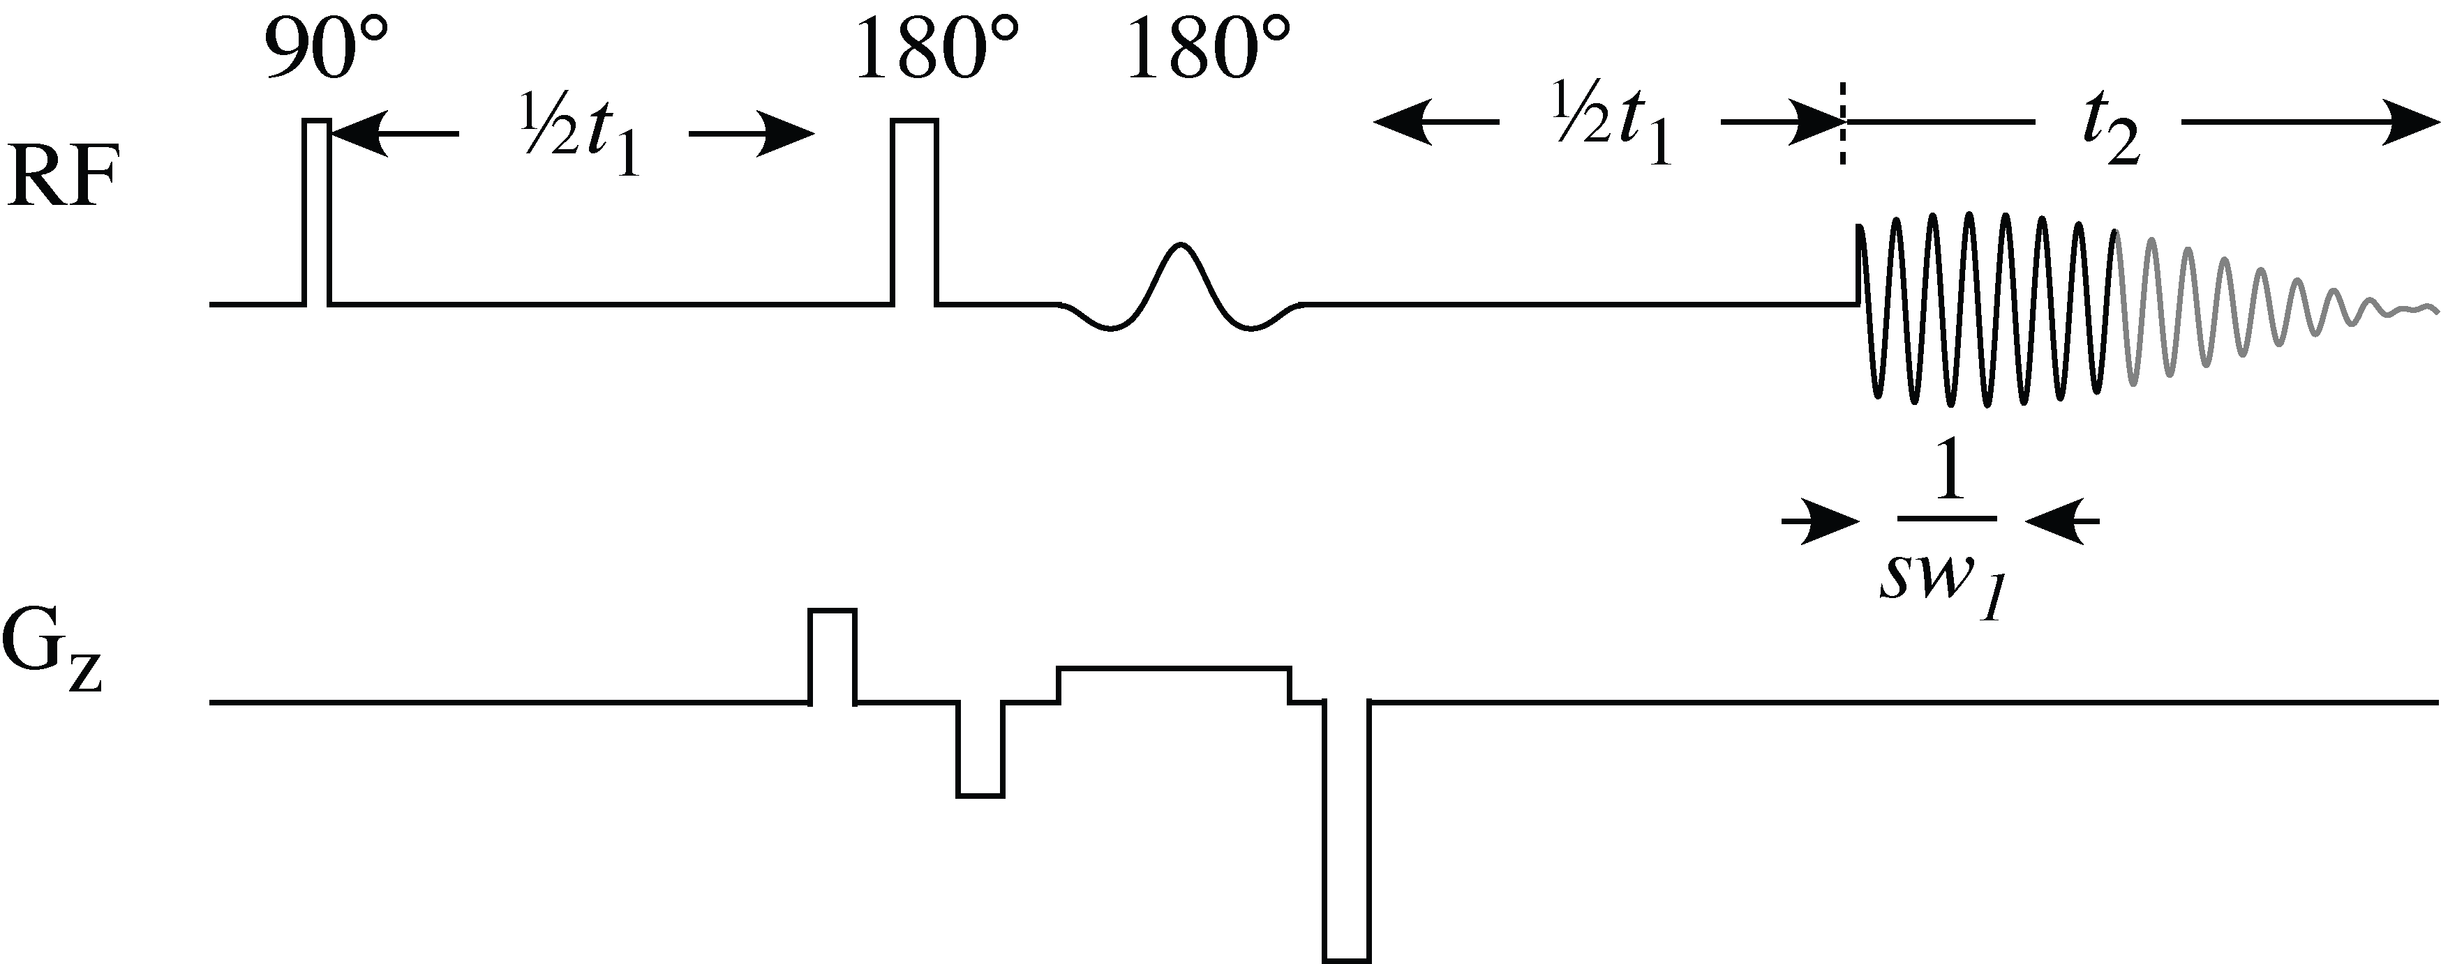
J-Refocusing: the Zangger-Sterk Sequence Revisited
Excite
J-refocus
Acquire
Using gradient pulses to enforce CTPs cleans up results and can remove the need for a slice-selective 90°pulse
δ
+
+
+
J
–
+
+
The combination of a hard 180° pulse and a slice- and shift-selective 180° pulse leaves the active spins (within the slice) unperturbed and the passive (outside the slice or at a different shift) inverted, refocusing the J modulation of the active spins.
J Magn Reson 124, 486 (1997)
Chem. Commun. 2007, 933

Slide 20
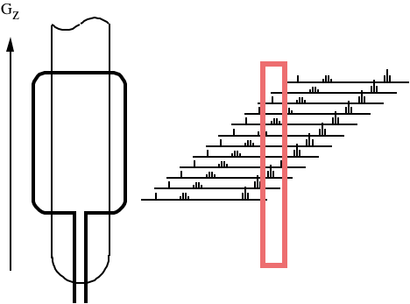
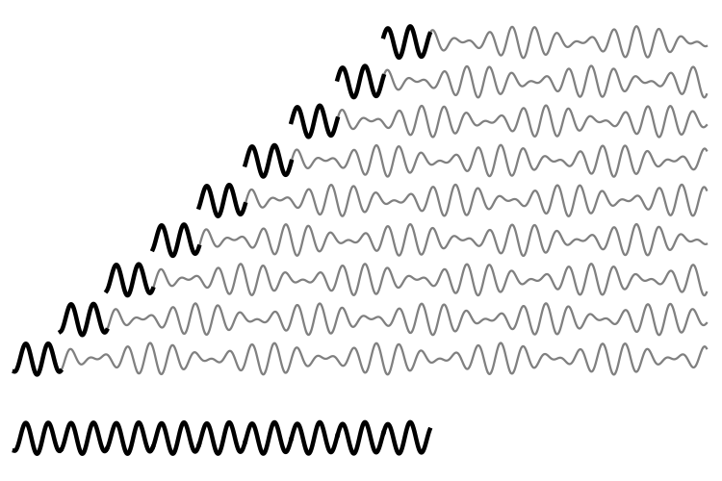
Mechanics of the Zangger-Sterk Experiment
J-refocusing
Data chunking
1/sw₁
t₁
t₂
The soft and hard 180° pulses invert the passive spins, refocusing J modulation but leaving shift evolution intact
J modulation is slow, so a block of data points lasting 1/sw₁ << 1/J can be measured for each value of t₁, building up a pure shift interferogram. (The residual effect of J is to cause weak sidebands at multiples of sw₁).

Slide 21
Taking the Zangger-Sterk Sequence Apart (1)
Maps out signal dependence on t₁, as in a 2D experiment
The soft 180° pulse with the weak field gradient inverts each resonance in a different thin slice of the sample
The strong gradient pulses select spins inverted by both 180° pulses, so the only signals seen are from the thin slices of sample – the “active spins”
I_{z}
–I_{y}
–I_{y} cos(2πδt₁)
+I_{x} sin(2πδt₁)
The active spins experience both 180° pulses, so do not have their shift refocused
–I_{y} cos(πδt₁) cos(πJt₁/2)
+I_{x} sin(πδt₁) cos(πJt₁/2)
+I_{x}S_{z} cos(πδt₁) sin(πJt₁/2)
–I_{y}S_{z} sin(πδt₁) sin(πJt₁/2)
–I_{y} cos(πδt₁) cos(πJt₁/2)
+I_{x} sin(πδt₁) cos(πJt₁/2)
–I_{x}S_{z} cos(πδt₁) sin(πJt₁/2)
+I_{y}S_{z} sin(πδt₁) sin(πJt₁/2)
The remaining, “passive”, spins are left inverted, so their coupling effect on the active spins is reversed – “J-refocusing”

Slide 22
Taking the Zangger-Sterk Sequence Apart (2)
The hard 180° pulse refocuses δ, but J continues to evolve for a time τ_{A}
The soft 180° pulse affects only one spin at a time, simply refocusing signals, so τ_{B} has no effect on shift or J evolution
τ_{A}
τ_{B}
The net effect is that J refocuses at a time t₁ + 1/(2 sw₁), at the midpoint of the chunk of data
In the original ZS experiment J was refocused at the end of t₁. Refocusing τ_{A} = 1/(2 sw₁) later means that twice as long a chunk of data can be acquired without increasing the effect of J modulation
(In practice, a few extra data points are acquired before the start of the chunk, but then thrown away, in order to avoid the distortions caused by receiver switch on and digital filtration)

Slide 23
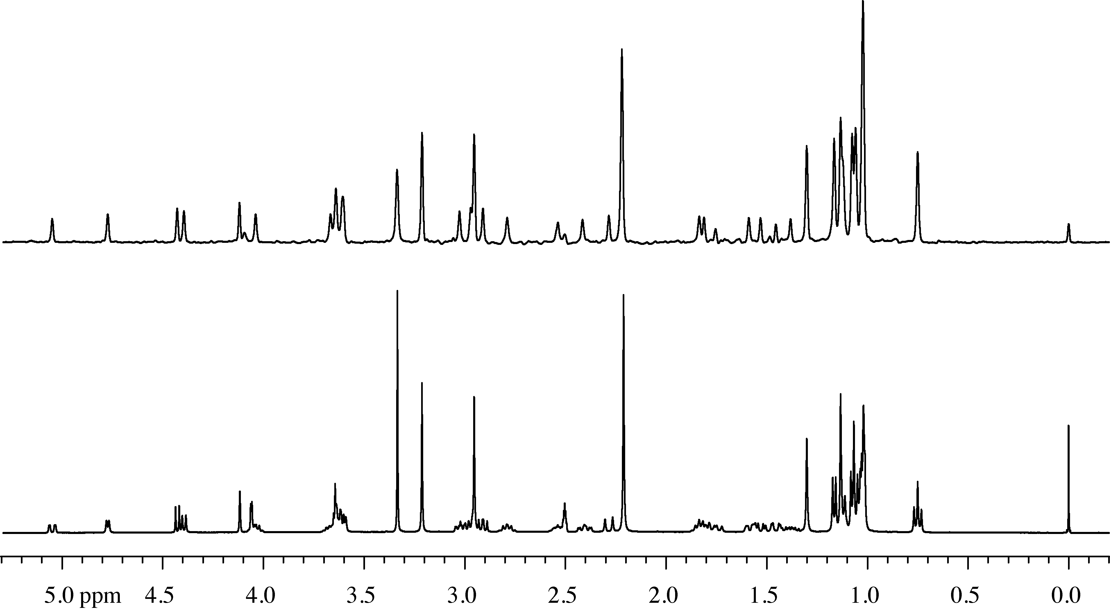
400 MHz Zangger-Sterk Pure Shift ¹H Spectrum of Clarithromycin
Pure shift spectrum
Conventional spectrum
J Am Chem Soc 132, 12770 (2010)

Slide 24
J-Refocused Pure Shift NMR: Acquisition Methods
Interferogram
(2D acquisition to build up an interferogram)
½t₁
½t₁
Excite
ASR
Acq
J-refocus
1/sw₁
J is refocused by the combination of a hard 180° pulse and an active spin refocusing (ASR) sequence element (in the ZS experiment, a soft pulse under a field gradient) at the midpoint of t₁. A pure shift interferogram is built up by incrementing t₁ in steps of 1/sw1. Slow but sure.
Real-time
(acquire an FID in real time)
[
]
Excite
Acq
ASR
Acq
J-refocus
n
In real-time experiments, acquisition of a FID is periodically interrupted by J-refocusing elements. Fast, but relaxation and other effects broaden the pure shift signals.
(An intermediate alternative is semi-real-time acquisition – J Magn Reson 293, 19-27 (2018))

Slide 25
Pulse Sequence Elements for “Active Spin Refocusing”
We divide the available spins into active spins that we observe, and passive spins that we manipulate. Combining an ASR element with a hard 180° pulse refocuses the effect on the active spins of any couplings to the passive spins.
“double β”
(PSYCHE)
BIRD
ZS
BS
BIlinear Rotation
Decoupling:
π rotation of
protons coupled
to ¹³C
Zangger-Sterk:
slice- / shift-
selective π rotation
Band-Selective
homonuclear
decoupling:
shift-selective
π rotation
PSYCHE / anti-z-COSY:
π rotation of a
fraction sin²β of spins

Slide 26

PSYCHE: Pure Shift Yielded by Chirp Excitation
Using two small flip angle β swept-frequency (chirp) pulses, with opposite sweep directions and under a field gradient, preserves only the subset of coherences (“diagonal peak” responses) that form a stimulated echo without changing frequency.
Angew Chem Int Ed 53, 6990 (2014)

Slide 27

Mechanism of PSYCHE (1)
RF
G_{z}
time
frequency
Consider two coupled spins A and X. In the presence of a field gradient, the times at which A and X are at resonance during the chirp pulses will vary with position, so we can treat each slice as experiencing a series of four small flip angle pulses β.

Slide 28
Mechanism of PSYCHE (2)
RF
G_{z}
“Diagonal peak” responses are refocused, and survive
M_{z}
time
frequency

Slide 29
Mechanism of PSYCHE (3)
RF
G_{z}
“Cross-peak” responses are dephased
M_{z}
time
frequency

Slide 30
Mechanism of PSYCHE (4)
RF
G_{z}
Zero quantum coherence pathways experience different evolution times in different slices, and average to zero
ZQC
time
frequency

Slide 31
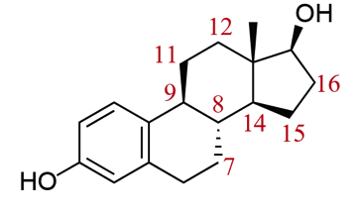
PSYCHE Sensitivity and Spectral Purity
Normal ¹H
PSYCHE
ZS, 12 ms rsnob
ZS, 100 ms rsnob
Comparing PSYCHE and ZS methods for a complex and strongly coupled region of the 500 MHz ¹H spectrum of estradiol, PSYCHE offers ca. 10× more S/N for similar spectral purity. In ZS, spectral purity is determined by selective pulse bandwidth; in PSYCHE, by β. (The sensitivity of ZS methods can be improved by using multiple frequency irradiation – nemo-ZS.)
The decoupled signal in PSYCHE ∝ 2 sin²βcos²β, the main (“recoupling”) artefact ∝ sin⁴β.
Angew Chem Int Ed 53, 6990 (2014)

Slide 32
Pure Shift NMR
History: What ? Why ? Who ? When ? How ?
Mechanics
Applications
Problems

Slide 33
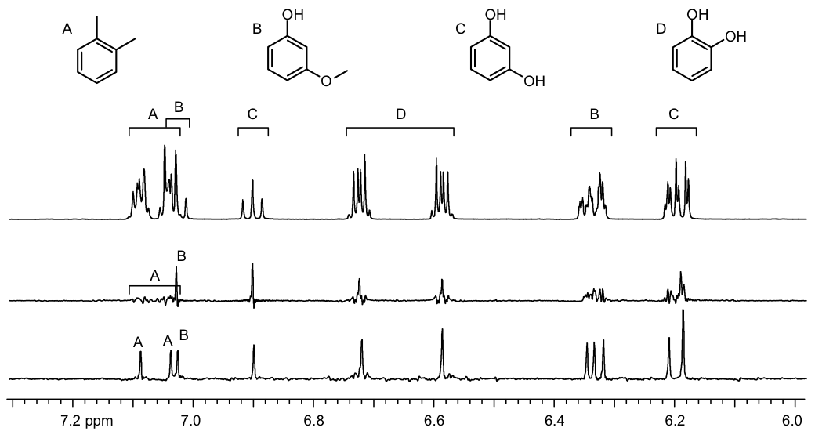
BIRD Pure Shift NMR of Strongly Coupled Aromatics
Normal
ZS
BIRD
Selecting only those protons directly bonded to ¹³C can lift ¹H degeneracy and restore weak coupling.
Angew Chem Int Ed 50, 9716 (2011)

Slide 34
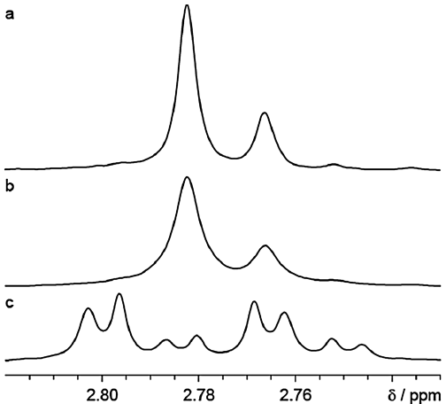
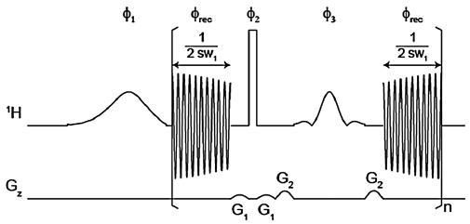
Real-time BS Pure Shift NMR of Hesperidin Diastereomers
ZS 73 min
RTBS < 2 min
[
]
n
Normal ¹H
Periodically inverting all except those protons within a specified frequency band – band-selective homonuclear decoupling, BASHD – suppresses the effects of couplings to protons within that band.
Chem Commun 50, 2512 (2014)

Slide 35
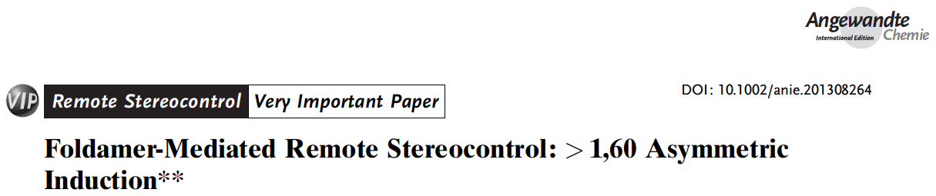
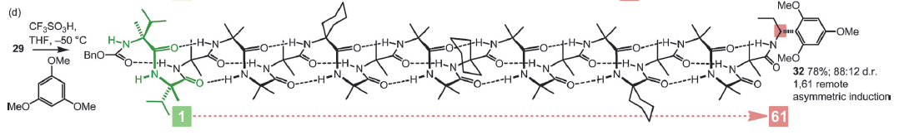
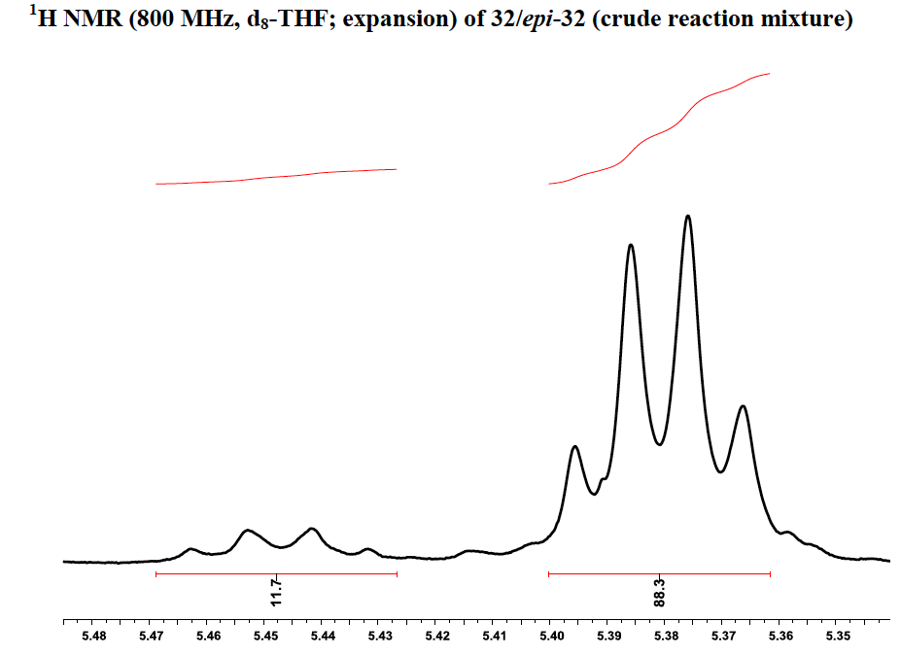
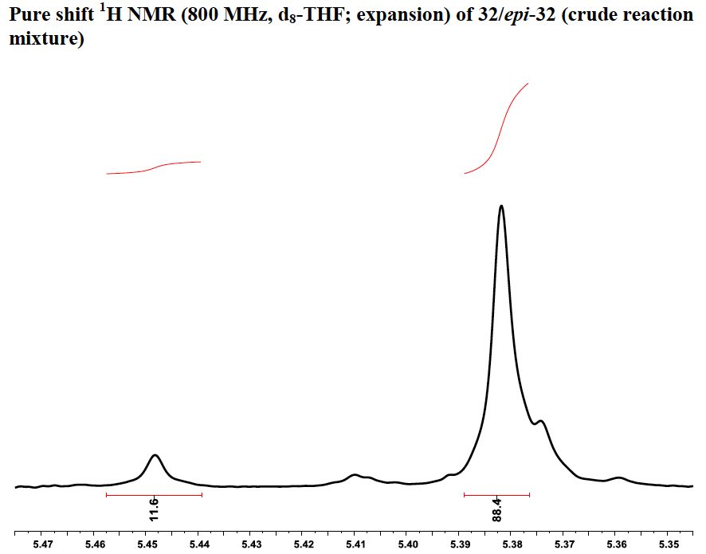
5.45 ppm
5.35
5.45 ppm
5.35
An 800 MHz real-time band-selective pure shift spectrum allows the enantiomeric excess induced at the end of the peptidomimetic chain to be determined reliably.
Angew Chem Int Ed 53, 151 (2014)

Slide 36
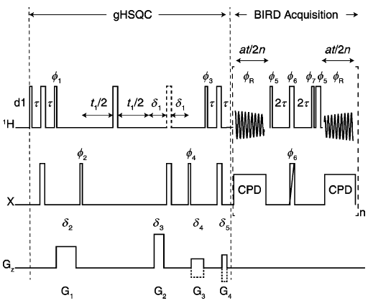
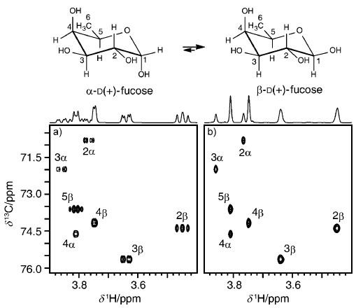
Real-Time BIRD Pure Shift HSQC
[
]
n
Periodic application of BIRD/180° sequence elements during data acquisition suppresses the effects of ¹H-¹H homonuclear couplings in real time. Unusually, pure shift here increases both resolution and sensitivity.
Angew Chem Int Ed 52, 11616 (2013)

Slide 37
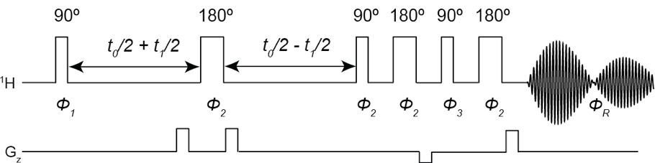
Pure shift CT-nQF-COSY
2D data are acquired conventionally, with constant time t₀ chosen to maximise cross-peaks. 2DFT gives an F₁-pure shift nQF-COSY, which can be covariance processed to yield a double pure shift nQF-COSY spectrum.
Angew Chem Int Ed 51, 6460 (2012)

Slide 38
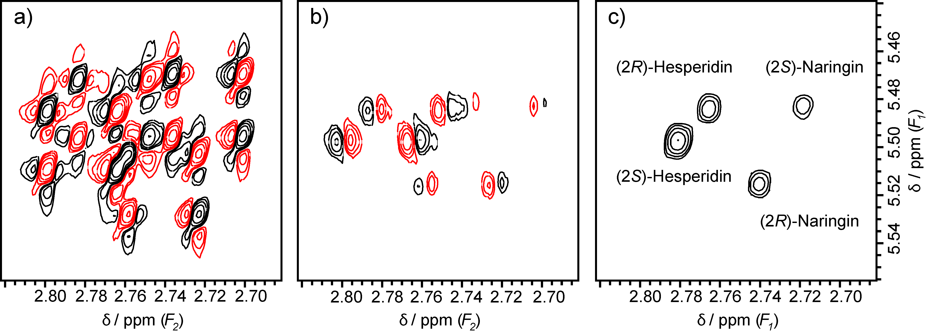
500 MHz pure shift CT-3QF-COSY: flavonoids
Normal 3QF-COSY (a), CT-3QF pure shift COSY (b), and covariance double pure shift CT-3QF-COSY (c) cross-peaks for a mixture of four flavonoids in DMSO-d₆; experiment time 127 min
Angew Chem Int Ed 51, 6460 (2012)

Slide 39
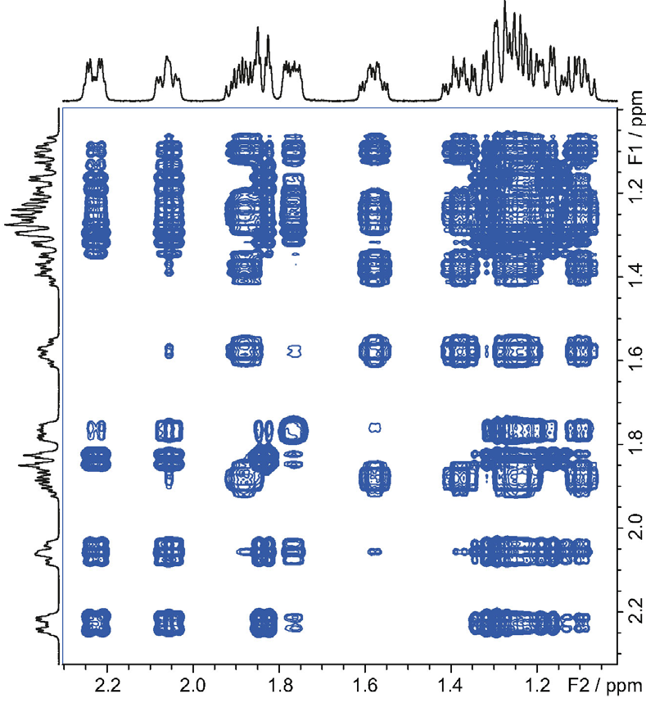
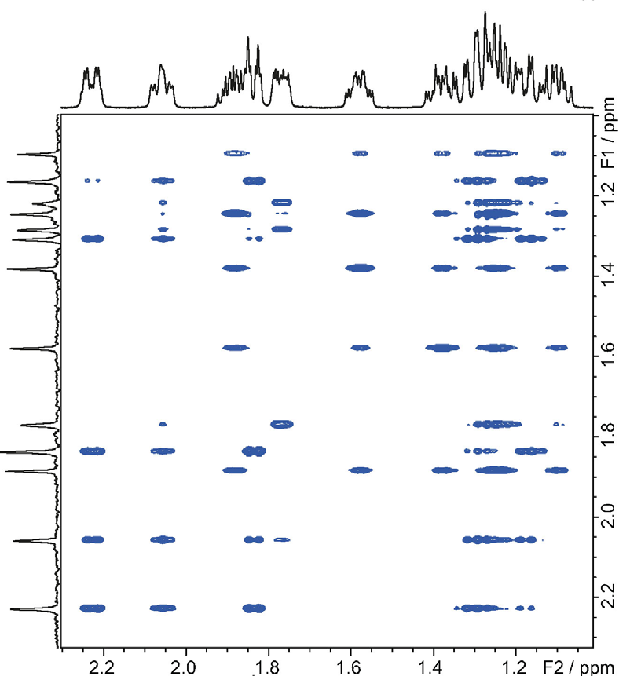
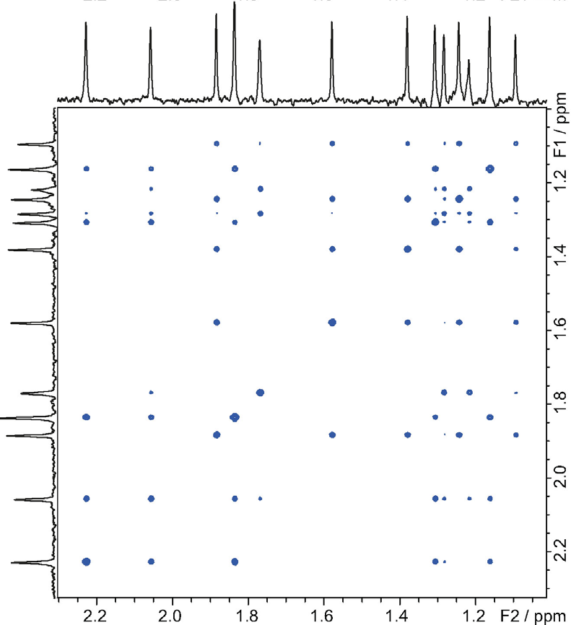
2D PSYCHE
TOCSY
F₁-PSYCHE-TOCSY
covariance-processed
F₁-PSYCHE-TOCSY
Using PSYCHE J-refocusing midway through t₁ in a TOCSY sequence then using covariance processing gives a completely decoupled estradiol TOCSY spectrum
J Am Chem Soc 136, 11867 (2014); Chem Eur J, in press; DOI: 10.1002/chem.201800524

Slide 40
Measuring Individual Couplings: PSYCHEDELIC
N-type modulation
R-type modulation
Pure Shift Yielded by Chirp Excitation to Deliver Individual Couplings: in a fully decoupled 2DJ spectrum, selective pulses reintroduce just the couplings to a chosen spin or spins
Angew Chem Int Ed 55, 1090 (2016)

Slide 41
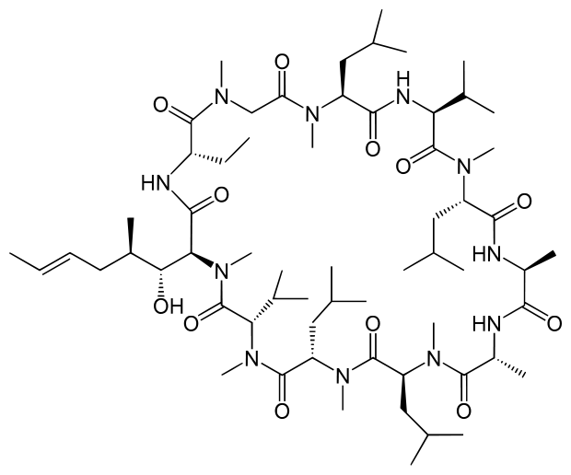
PSYCHEDELIC spectrum of cyclosporin A
Applying the selective pulses to the H_{α} region allows all the couplings to this region to be measured without interference or overlap
Angew Chem Int Ed 55, 1090 (2016)

Slide 42
Pure Shift NMR
The History: What ? Why ? Who ? When ? How ?
The Mechanics
Some Applications
Some Problems:
strong coupling, sidebands and artefacts

Slide 43
Strong coupling
ββ
ββ
ββ
αβ
βα
αβ cosθ +
βα sinθ
βα cosθ –
αβ sinθ
(αβ+βα)/√2
(αβ–βα)/√2
180°
180°
180°
αα
αα
αα
A
X
A
B
A₂
When Δδ is not large compared to J, transverse components of magnetization (I_{x}S_{x}+I_{y}S_{y}) interact as well as longitudinal (I_{z}S_{z}). This causes the spin states to mix, changing the relative strengths of coherences and opening up new coherence transfer pathways.

Slide 44
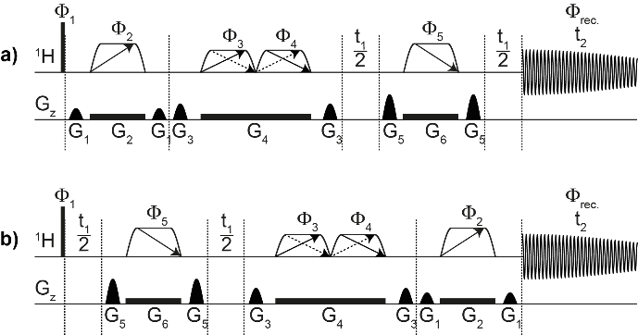
Triple Spin Echo PSYCHE 2DJ Spectroscopy
Normal (N)
Reversed (R)
Chirp pulses generate echo at start of acquisition, but dephase signals that change shift, attenuating strong coupling artefacts
PSYCHE reverses sense of J evolution
before (N) or after (R) evolution period,
allowing echo/anti-echo processing
Chem Commun 51, 15410 (2015)

Slide 45
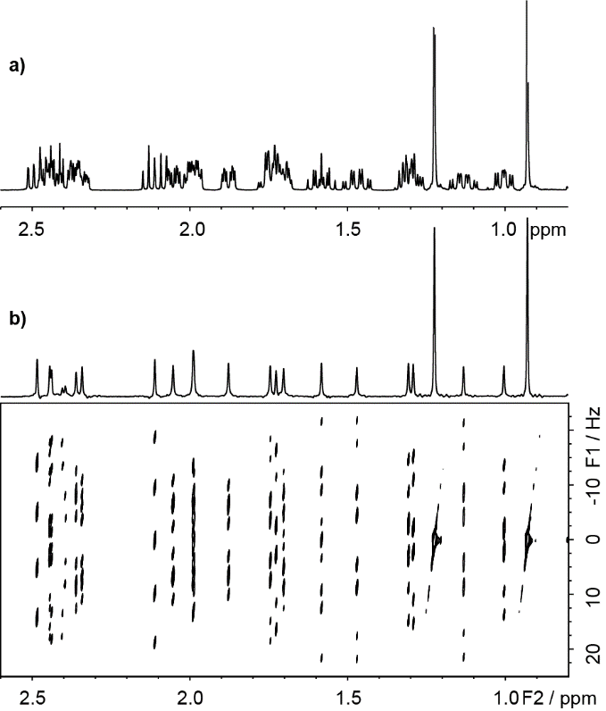
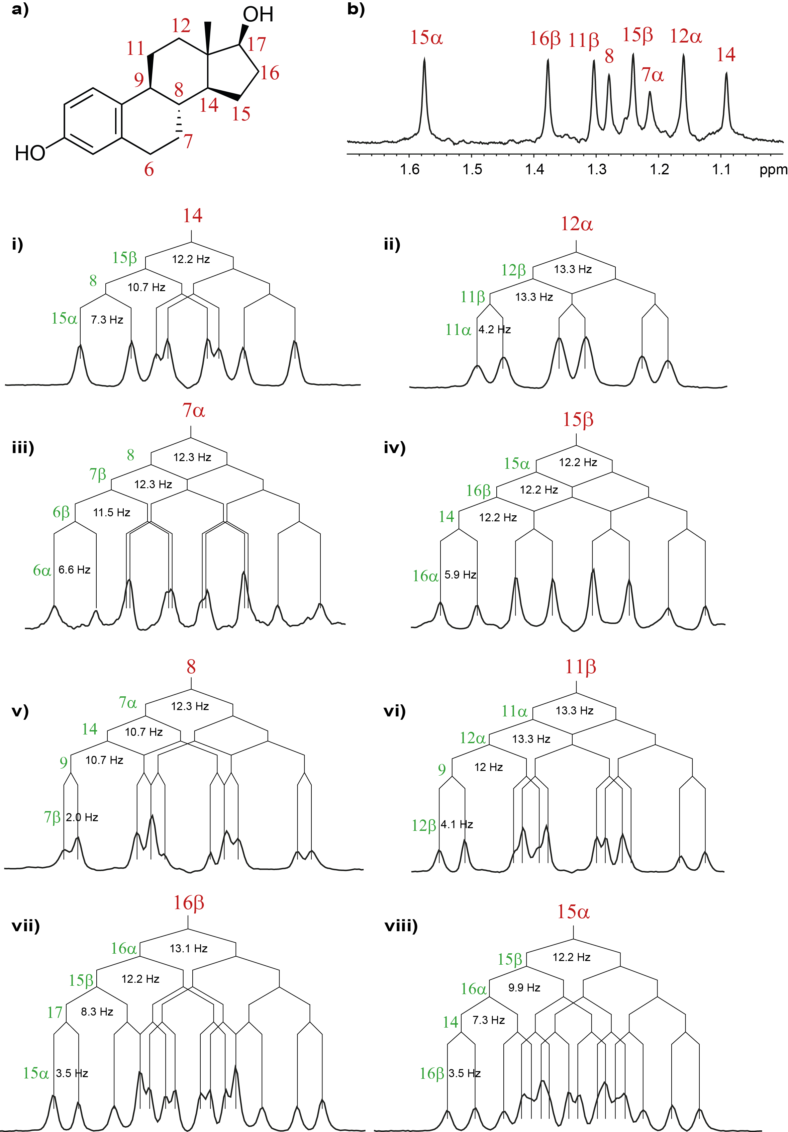
Triple Spin Echo PSYCHE 2DJ Spectroscopy
TSE-PSYCHE ¹H 2DJ spectrum of estradiol
2DJ spectrum is now in pure absorption
mode, so 45° projection works fine
Chem Commun 51, 15410 (2015)

Slide 46
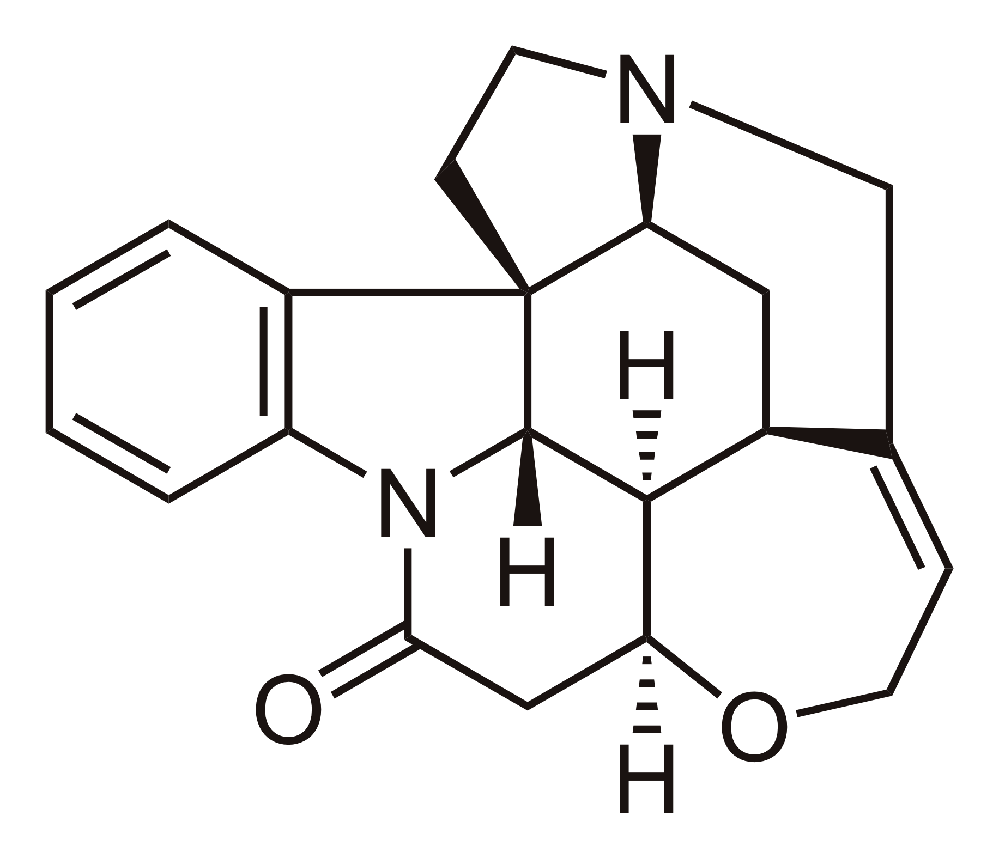
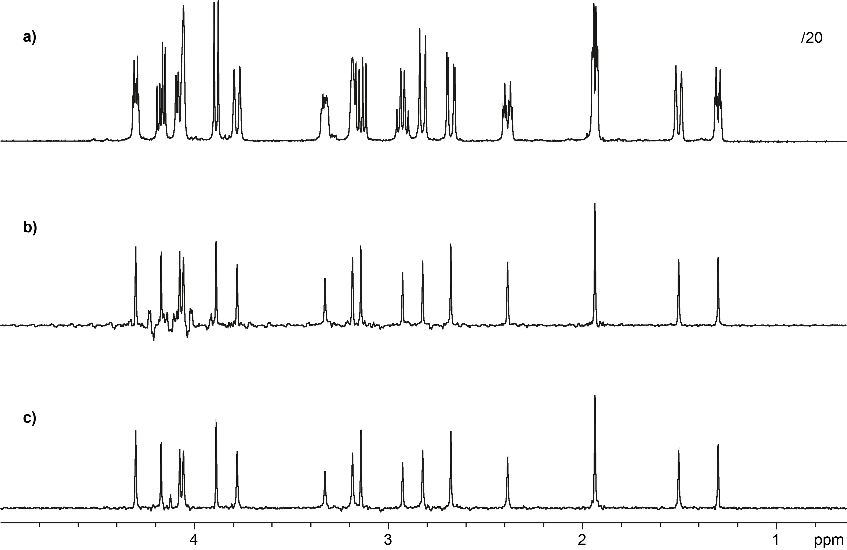
1D TSE-PSYCHE: Tolerance of Strong Coupling
/20
Normal ¹H
PSYCHE
TSE-PSYCHE
The TSE-PSYCHE 2DJ sequence can also be used to measure 1D spectra
Chem Commun 51, 15410 (2015)

Slide 47
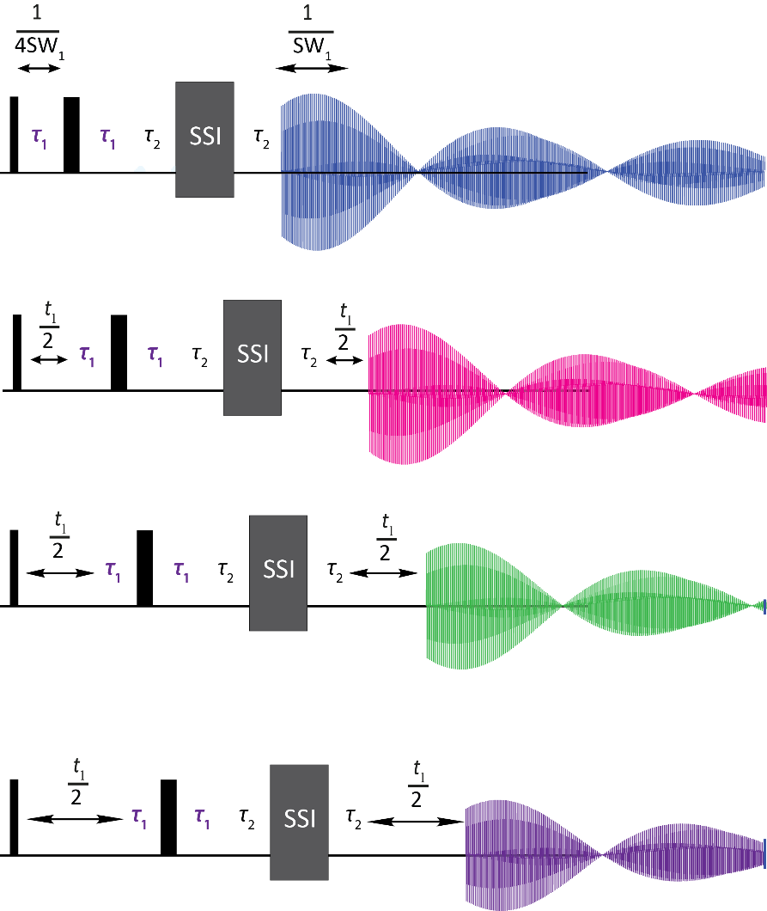
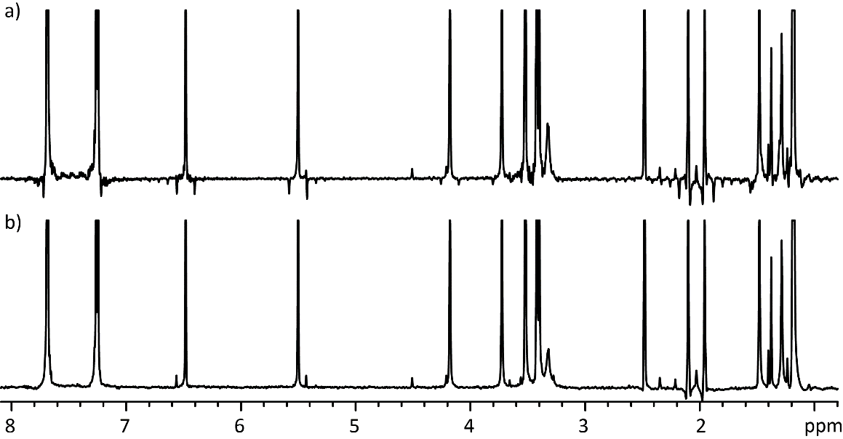

Constructing a Pure Shift FID: chunking sidebands
t₁ = 0
ASR
1/sw₁ << 1/J_{HH}
t₁ = 1/sw₁
ASR
t₁ = 2/sw₁
ASR
t₁ = 3/sw₁
ASR
Successive experiments map out the decoupled signals. The residual effect of the couplings is to impose a small modulation of the assembled interferogram, with period 1/sw₁, leading to small sidebands in the resulting spectrum with spacing sw₁.
J Magn Reson 271, 99 (2016)

Slide 48
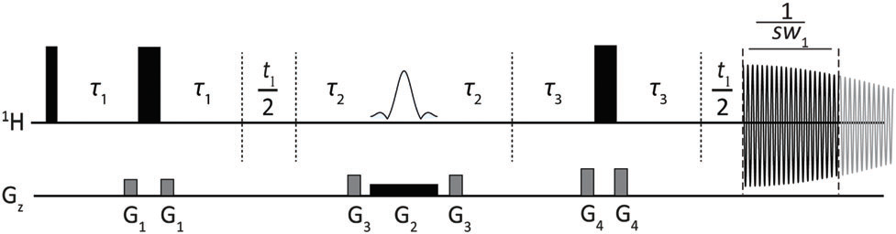
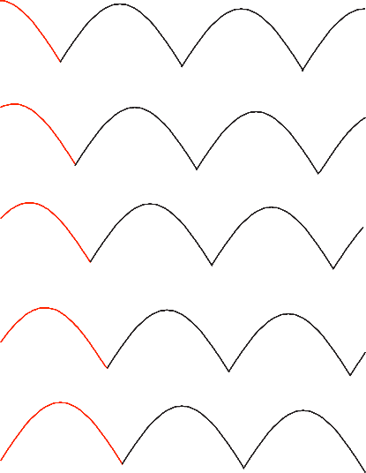


Changing the Residual J Modulation Phase: principle
τ_{J} = 0
τ_{J} = –1/(16 sw₁)
τ_{J} = 1/(16 sw₁)
τ_{J} = –2/(16 sw₁)
τ_{J} = 2/(16 sw₁)
τ_{J} = –3/(16 sw₁)
τ_{J} = 3/(16 sw₁)
Average
τ_{J} = 4/(16 sw₁)
Varying the net J evolution delay τ_{J} = 2(τ₁ – τ₃) changes the modulation phase, and hence the phases of the sideband signals. Averaging N different delays suppresses sidebands to order N–1.

Slide 49

Changing the Residual J Modulation Phase: practice
τ_{J}
modulation phase
–3/(16 sw₁)
–135°
–2/(16 sw₁)
–90°
–1/(16 sw₁)
–45°
0
0
1/(16 sw₁)
45°
2/(16 sw₁)
90°
3/(16 sw₁)
135°
4/(16 sw₁)
180°
Sidebands go through 360n° phase shifts while the centreband signals are unchanged

Slide 50

Ultraclean Pure Shift NMR: SAPPHIRE sideband suppression
1
2
Normal ZS pure
shift spectrum
ZS pure shift spectrum with sideband suppression
40 mM rosuvastatin (1) and 1 mM BEM (2) in DMSO-d₆
Sideband Averaging by Periodic PHase Incrementation of Residual J Evolution allows reliable detection of signals of minor component signals
Chem Commun 53, 10188 (2017)

Slide 51


Improving PSYCHE: Saltire Pulses
Normal PSYCHE “double β” sequence element
Double saltire element gives four times weaker recoupling artefacts
Adding two counter-sweeping chirp pulses gives a “saltire” pulse (named after the national flag of Scotland)
Single saltire element gives four times weaker recoupling artefacts and improves suppression of strong coupling and ZQC artefacts
Chem Eur J, in press; DOI: 10.1002/chem.201800524

Slide 52
Background Reading
“Pure Shift NMR Spectroscopy”, R. W. Adams, in eMagRes, Wiley, 2014, DOI: 10.1002/9780470034590.emrstm1362
“Broadband ¹H homodecoupled NMR experiments: recent developments, methods and applications”, L. Castañar, T. Parella, Magn. Reson. Chem. 53, 399–426 (2015)
“Pure Shift NMR”, K. Zangger, Prog. Nucl. Magn. Reson. Spectrosc. 86–87, 1–20 (2015)
“Pure shift ¹H NMR: what is next?”, L. Castañar, Magn. Reson. Chem. 57, 47–53 (2017)
“PSYCHE Pure Shift NMR Spectroscopy”, M. Foroozandeh, G.A. Morris and M. Nilsson, Chem. Eur. J in press, DOI: 10.1002/chem.201800524

Slide 53
https://www.nmr.chemistry.manchester.ac.uk/?q=node/415

Slide 54









Acknowledgments
Ralph Adams, Juan Aguilar,
Laura Castañar, Yingxian Chen,
Jonathan Clayden, Guilherme Dal Poggetto,
Mohammadali Foroozandeh, Peter Kiraly,
Pinelopi Moutzouri, Mathias Nilsson,
Liladhar Paudel Manchester
Steve Coombes, Andy Phillips AstraZeneca
Davy Sinnaeve Gent
Julia Cassani Mexico City
Ralph Adams, Juan Aguilar,
Laura Castañar, Yingxian Chen,
Jonathan Clayden, Guilherme Dal Poggetto,
Mohammadali Foroozandeh, Peter Kiraly,
Pinelopi Moutzouri, Mathias Nilsson,
Liladhar Paudel Manchester
Steve Coombes, Andy Phillips AstraZeneca
Davy Sinnaeve Gent
Julia Cassani Mexico City

